Slide 1





(click on a button to go directly to that step)
Notes:
The thinkalong toolkit includes assessment-style items with answer keys. A digital version (poster) of the thinkalong routine and daily questions for teacher and students’ reference is also included.

Slide 2
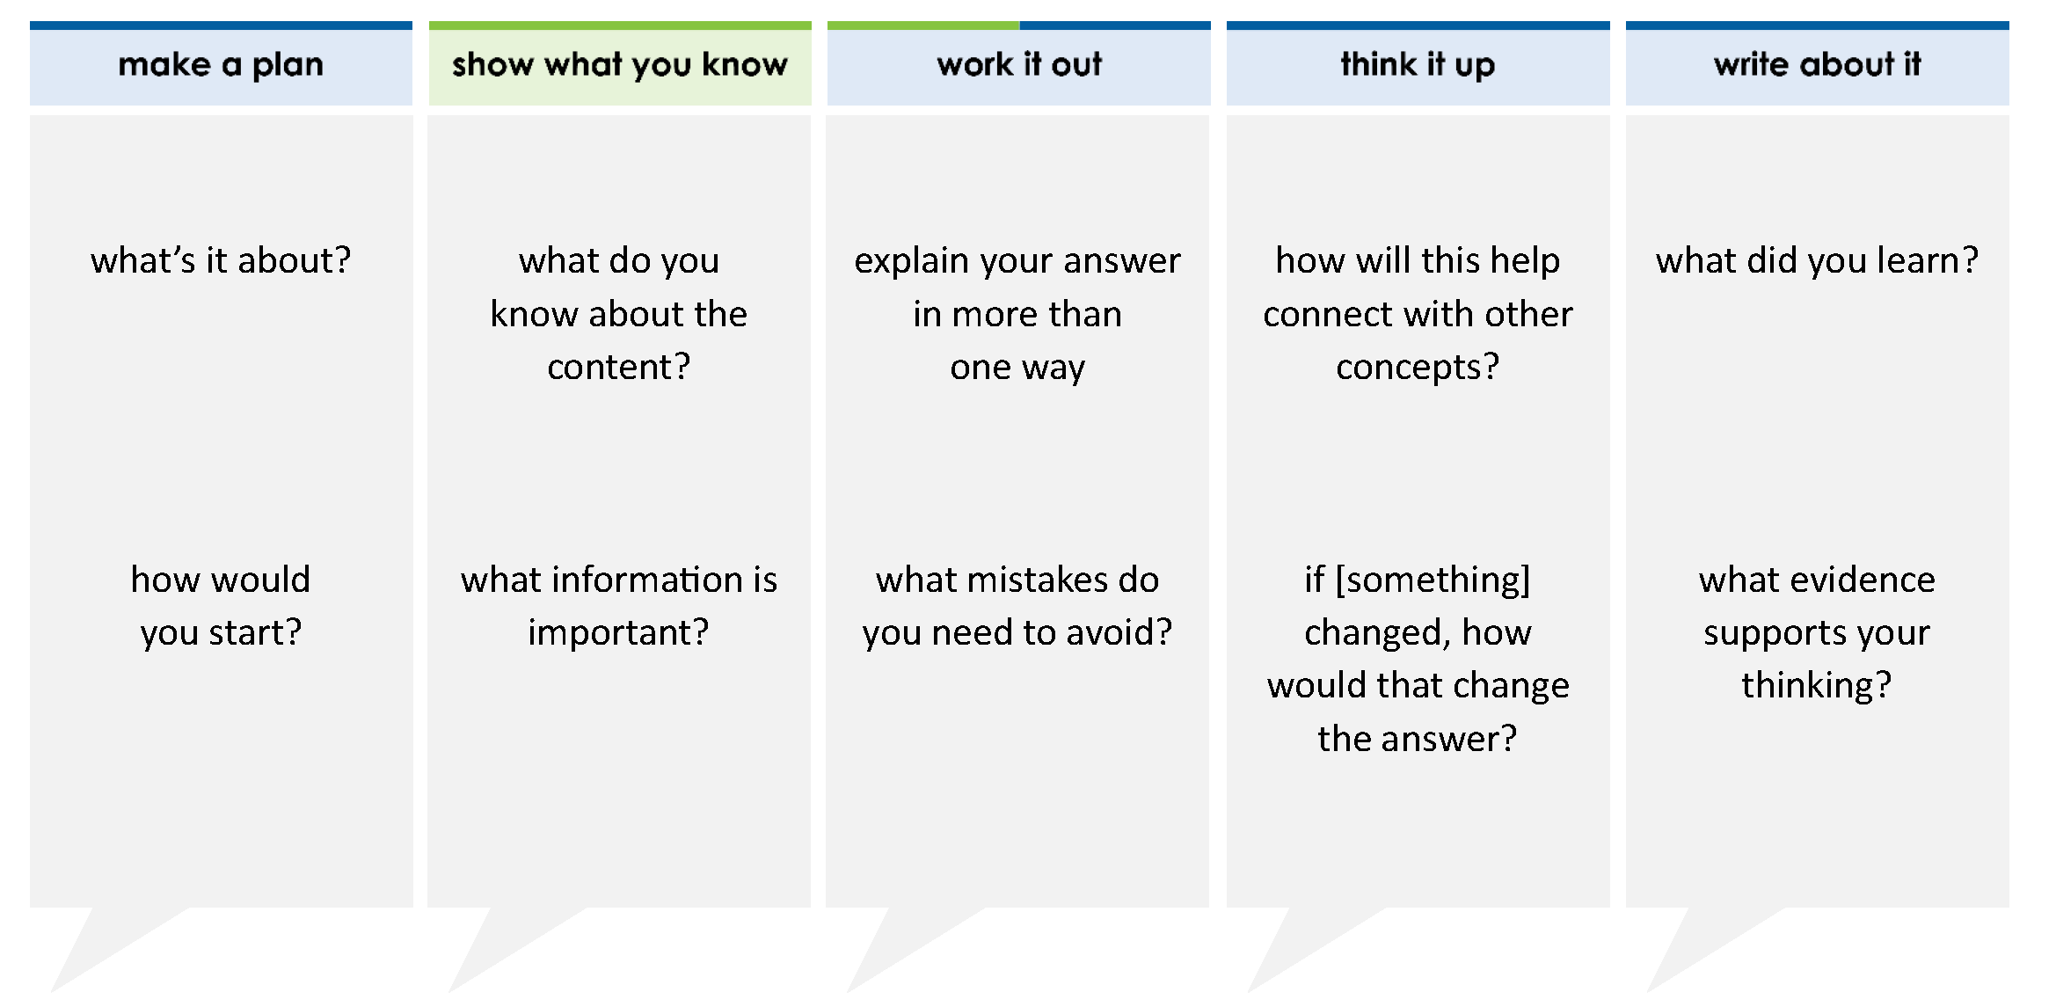
The list shows clues about a number:
the digit 7 has a value of (7 x 0.01)
the digit 3 has a value of (3 x 100)
the digit 2 has a value of (2 x 1,000)
Which number fits these three clues?
A 2,358.7
B 2,762.03
C 2,362.47
D 241,362.47
thinkalong routine
stimulus
Notes:
Throughout the week, use the guiding questions from the thinkalong routine to lead student thinking and discussion around the selected stimulus (problem, text, or visual) aligned to a high-impact standard/concept.

Slide 3
make a plan
Notes:
make a plan
The goal of the first 5-10 minutes of the routine is just for students to explore. We are engaging the “tools to know” process standards and using the selected problem, text, or visual to activate memory around the designated content for the week.
If you’re using a problem as the stimulus, students don’t solve the problem or even see the answer choices yet! In this part of the routine, students practice making a plan, getting started, and thinking about what they will need to answer the question based on the vocabulary and/or visuals included.

Slide 4
The list shows clues about a number:
the digit 7 has a value of (7 x 0.01)
the digit 3 has a value of (5 x 100)
the digit 2 has a value of (2 x 1,000)
what’s it about?
how would you start?
Notes:
make a plan: Use the guiding questions on the routine to drive the thinking and discussion with students as you explore the selected stimulus.
This item was selected to address, loopback, or intervene on decimal place value because:
Place value understanding and representations are a foundational skill that will continue into future learning.
This problem will have students go from a verbal description to number form.

Slide 5
show what you know
Notes:
show what you know
The goal of the second 10 minutes in the routine is for students to talk using the problem, text, or visual to show what they know about this concept! This part of the routine allows students and teacher to talk about, share, and clarify the content (vocabulary, visuals, activities, common mistakes, connections, key ideas, important info/details, etc.).

Slide 6
The list shows clues about a number:
the digit 7 has a value of (7 x 0.01)
the digit 3 has a value of (5 x 100)
the digit 2 has a value of (2 x 1,000)
what do you know about the content?
what information is important?
Notes:
show what you know - option 1: Use these questions from the routine, along with the selected stimulus, to activate memory, review content, correct learning mistakes, and clarify misconceptions. Be sure discussion includes important information related to the selected stimulus.
important information about this item:
Clues include and require an understanding of important academic vocabulary: digit, value, tenths, hundredths.
Students must read and clarify all of the clues.
A number can be generated with each of these clues when the digit is placed in the correct place value.
Students would benefit from creating a place value chart, use of manipulatives, writing the number in various forms (standard form, expanded form, etc.).

Slide 7



  just the facts
The list shows clues about a number:
the digit 7 has a value of (7 x 0.01)
the digit 3 has a value of (5 x 100)
the digit 2 has a value of (2 x 1,000)
Notes:
show what you know - option 2: just the facts (rehearsal and practice instructional strategy)
purpose
The purpose is to help student identify the most important details from a problem or visual.
instructions
Students read a text and observe an image.
They determine 3 facts (interesting, useful, most important) from the stem.
An interesting fact might be that the values are not in order from greatest value to least – they are scrambled.
A useful fact might be that the place values are listed in the expanded notation which makes placing them into a place value chart easy.
An important fact might be that some of the values are missing.
3. With a thinking partner, students justify why they chose a particular fact.
4. Observe students’ thinking and clarify/verify as appropriate.

Slide 8
work it out
Notes:
work it out
The goal of the third 10 minutes of the routine is for students to work out the problem and defend their answer. We want students to prove why their chosen response is right and explain why the incorrect answers are wrong.

Slide 9
The list shows clues about a number:
the digit 7 has a value of (7 x 0.01)
the digit 3 has a value of (3 x 100)
the digit 2 has a value of (2 x 1,000)
Which number fits these three clues?
A 2,358.7
B 2,762.03
C 2,362.47
D 241,362.47
explain your answer in more than one way
what mistakes do you need to avoid?
Notes:
work it out - option 1: Correct learning mistakes and clarify misconceptions by answering the question but be sure students not only solve but also prove why their chosen response is right and explain why the incorrect answers are wrong.
Be sure discussion includes:
A is incorrect - the student most likely confused the tenths with the hundredths place
B is incorrect - the student most likely confused the hundredths with the hundreds place
C is correct
D is incorrect - the student most likely was careless with the digit 2 and didn’t pay attention to it being in the thousands place or saw that it was in the greatest place value

Slide 10
  make the case
The list shows clues about a number:
the digit 7 has a value of (7 x 0.01)
the digit 3 has a value of (3 x 100)
the digit 2 has a value of (2 x 1,000)
Which number fits these three clues?
A 2,358.7
B 2,762.03
C 2,362.47
D 241,362.47
defend why your answer might be correct/incorrect
what 1-2 pieces of evidence do you have?
Notes:
work it out - option 2: make the case (learning from mistakes instructional strategy)
free virtual dice available in the lead4ward app and at: www.lead4ward.com/dice
purpose
Students correct learning mistakes and clarify misconceptions by justifying/proving why their assigned response is right OR explain why their assigned response is an incorrect answer.
instructions
Organize students into groups (no larger than 4).
Assign each team a potential answer (choice).
Groups huddle to determine if their answer choice is “correct/innocent” by explaining why and providing (at most) 2 pieces of evidence…or “incorrect/guilty” by explaining why and providing (at most) 2 pieces of evidence.
Students prosecute and defend arguments.
Observe students’ thinking/responses and clarify/verify as appropriate.
be sure discussion includes:
Visuals or models students might use to prove their justification.
Discourse around strategies, clues and/or vocabulary that support their justification.
The chosen incorrect answer(s) suggests a common misconception, guessing pattern, clue picking, stopping too soon, and relying on tricks.
Student-driven discourse.

Slide 11
think it up
Notes:
think it up
The goal of the fourth 10 minutes of the routine is for us to change things up so students can practice with novelty and transfer.

Slide 12
how will this help connect with ordering decimal numbers?
The list shows clues about a number:
the digit 7 has a value of (7 x 0.01)
the digit 3 has a value of (3 x 100)
the digit 2 has a value of (2 x 1,000)
Which number fits these three clues?
A 2,358.7
B 2,762.03
C 2,362.47
D 241,362.47
if the 3 and 7 switched places, how would that change the answer?
Notes:
think it up - option 1: Use the guiding questions on the routine to drive the thinking and discussion with students as they reflect on the work of the routine so far -- the thinking around the content and the problem, text or visual. Then, have students analyze how all of that can help them as they work on or think through other content or solving future problems.

Slide 13
  odd one out
The list shows clues about a number:
the digit 7 has a value of (7 x 0.01)
the digit 3 has a value of (3 x 100)
the digit 2 has a value of (2 x 1,000)
Which number fits these three clues?
A 2,358.7
B 2,762.03
C 2,362.47
D 241,362.47
How is the number 5,001.8 written in expanded notation?
A number is shown in expanded notation.
(5 x 10,000) + (9 x 100) + (2 x 1) + (4 x 0.1) + (3 x 0.01)
What is this number in standard form?
In which of these does the digit 3 have a value of 3 x 0.1?
Select two correct answers.
one and three hundredths
twenty-one and three tenths
3.1
3.0
14.36
Notes:
think it up - option 2 odd one out (extending thinking instructional strategy)
purpose
Students compare/contrast four visuals, assessment questions, words, characters, historical figures, etc. and justify their thinking by defending which they think is the odd one out.
instructions
Divide students into groups of 4.
In each group, students divide the images/problems amongst their group and take turns describing their image/problem.
Students compare and contrast the images/problems.
Students determine which one is the odd one out and why.
Groups share out their selected odd one out and justification.
Observe and listen to students’ thinking and clarify/verify as appropriate.

Slide 14
write about it
Notes:
write about it
The goal of the last 10 minutes of the routine is for students to reflect on the routine and write about how it affected their understanding and confidence around the content and problem-solving process.

Slide 15
what did you learn?
The list shows clues about a number:
the digit 7 has a value of (7 x 0.01)
the digit 3 has a value of (3 x 100)
the digit 2 has a value of (2 x 1,000)
Which number fits these three clues?
A 2,358.7
B 2,762.03
C 2,362.47
D 241,362.47
explain why C is correct
what evidence supports your thinking?
what mistake can easily be made (that you need to avoid)?
Notes:
write about it: The goal of the last 10 minutes of the routine is to solidify learning and have students practice communicating what they know in writing.
Ask students to:
think about the activities, questions, discussions, and the selected problem, text or visual for this week’s thinkalong routine
talk with a partner or in a small group about what they learned and the evidence that supports their thinking
write their answers on a piece of paper or in their notebooks
Review areas in which students may need more support.

