Slide 1





(click on a button to go directly to that step)
Notes:
The thinkalong toolkit includes assessment-style items with answer keys. A digital version (poster) of the thinkalong routine and daily questions for teacher and students’ reference is also included.

Slide 2
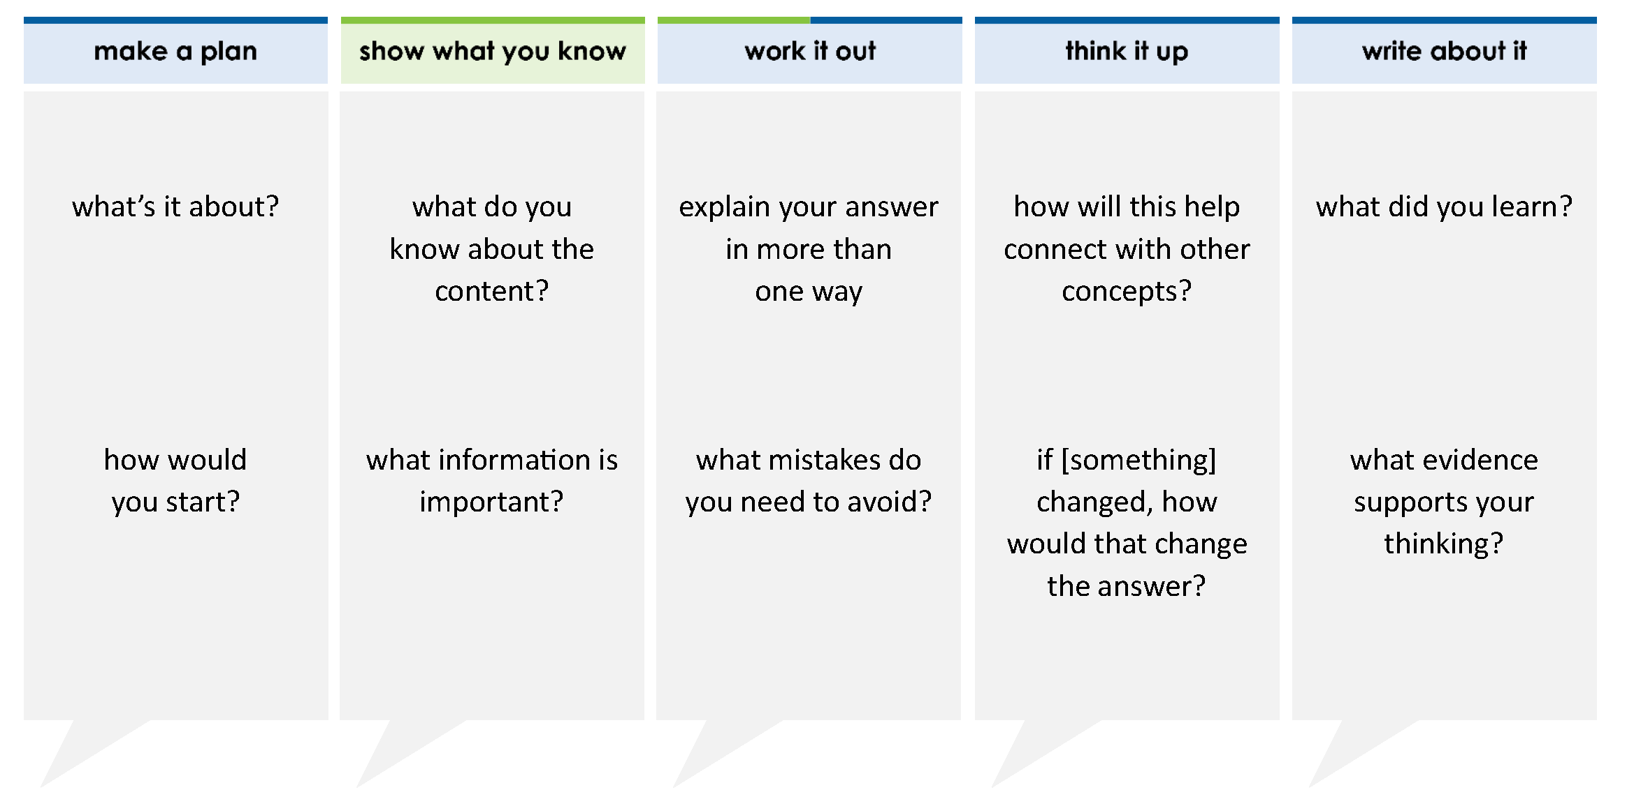
How is the number 4,002.7 written in expanded notation? Move the correct answer to each box. Not all answers will be used.
(4 x ) + (2 x ) + (7 x )
0.1
100
1,000
0.01
1,000,000
10
1
10,000
100,000
thinkalong routine
stimulus
Notes:
Throughout the week, use the guiding questions from the thinkalong routine to lead student thinking and discussion around the selected stimulus (problem, text, or visual) aligned to a high-impact standard/concept.

Slide 3
make a plan
Notes:
make a plan
The goal of the first 5-10 minutes of the routine is just for students to explore. We are engaging the “tools to know” process standards and using the selected problem, text, or visual to activate memory around the designated content for the week.
If you’re using a problem as the stimulus, students don’t solve the problem or even see the answer choices yet! In this part of the routine, students practice making a plan, getting started, and thinking about what they will need to answer the question based on the vocabulary and/or visuals included.

Slide 4
what’s it about?
(4 x 1,000) + (2 x 1) + (7 x 0.1)
how would you start?
Notes:
make a plan: Use the guiding questions on the routine to drive the thinking and discussion with students as you explore the selected stimulus.
This item was selected to address, loopback, or intervene on representing whole numbers and decimals because:
Expanded form and notation is critical to foundational place value understanding, especially with rational numbers.
This particular problem includes place values that will have a 0.

Slide 5
show what you know
Notes:
show what you know
The goal of the second 10 minutes in the routine is for students to talk using the problem, text, or visual to show what they know about this concept! This part of the routine allows students and teacher to talk about, share, and clarify the content (vocabulary, visuals, activities, common mistakes, connections, key ideas, important info/details, etc.).

Slide 6
what do you know about the content?
(4 x 1,000) + (2 x 1) + (7 x 0.1)
what information is important?
Notes:
show what you know - option 1: Use these questions from the routine, along with the selected stimulus, to activate memory, review content, correct learning mistakes, and clarify misconceptions. Be sure discussion includes important information related to the selected stimulus.
important information about this item:
Clues include and require an understanding of important academic vocabulary: expanded notation, tenths, hundredths.
Students must read and clarify all of the clues:
4 x 1,000 = 4,000
2 x 1 = 2
7 x 0.1 = 7 tenths or 0.7
Students would benefit from:
Placing these values into a place value chart
Possibly building a model of the number

Slide 7



  just the facts
(4 x 1,000) + (2 x 1) + (7 x 0.1)
Notes:
show what you know - option 2: just the facts (rehearsal and practice instructional strategy)
purpose
The purpose is to help student identify the most important details from a problem or visual.
instructions
Students read a text and observe an image.
They determine 3 facts (interesting, useful, most important) from the stem.
Students might say that an interesting fact is there are some place value missing.
Students might say a useful fact is that the values are in order from greatest (1,000) to least (0.1).
Students might say an important fact is that the values are present, making it helpful to fill in a place value chart.
3. With a thinking partner, students justify why they chose a particular fact.
4. Observe students’ thinking and clarify/verify as appropriate.

Slide 8
work it out
Notes:
work it out
The goal of the third 10 minutes of the routine is for students to work out the problem and defend their answer. We want students to prove why their chosen response is right and explain why the incorrect answers are wrong.

Slide 9
How is the number 4,002.7 written in expanded notation? Move the correct answer to each box. Not all answers will be used.
(4 x ) + (2 x ) + (7 x )
explain your answers in more than one way
0.1
100
1,000
0.01
1,000,000
10
1
10,000
100,000
what mistakes do you need to avoid?
Notes:
work it out - option 1: Correct learning mistakes and clarify misconceptions by answering the question but be sure students not only solve but also prove why their chosen response is right and explain why the incorrect answers are wrong.
Be sure discussion includes:
Place value understandings
The hundreds and tens places have a value of zero, which means they will not be used in the expanded form (e.g., students would not need to write 0 x 100)
Differences between tenths and hundredths

Slide 10
  make the case
How is the number 4,002.7 written in expanded notation? Move the correct answer to each box. Not all answers will be used.
(4 x ) + (2 x ) + (7 x )
defend why your answer might be correct/incorrect
what 1-2 pieces of evidence do you have?
0.1
100
1,000
0.01
1,000,000
10
1
10,000
100,000
A (4 x ) + (2 x ) + (7 x )
10,000
10
1
B (4 x ) + (2 x ) + (7 x )
1,000
100
1
C (4 x ) + (2 x ) + (7 x )
1,000
1
0.1
100
10
1
D (4 x ) + (2 x ) + (7 x )
Notes:
work it out - option 2: make the case (learning from mistakes instructional strategy)
free virtual dice available in the lead4ward app and at: www.lead4ward.com/dice
purpose
Students correct learning mistakes and clarify misconceptions by justifying/proving why their assigned response is right OR explain why their assigned response is an incorrect answer.
instructions
Organize students into groups (no larger than 4).
Assign each team a potential answer (choice). (Color coded answer choices allow you to assign each group a different color/answer to defend.)
Groups huddle to determine if their answer choice is “correct/innocent” by explaining why and providing (at most) 2 pieces of evidence…or “incorrect/guilty” by explaining why and providing (at most) 2 pieces of evidence.
Students prosecute and defend arguments.
Observe students’ thinking/responses and clarify/verify as appropriate.
be sure discussion includes:
Visuals or models students might use to prove their justification.
Discourse around strategies, clues and/or vocabulary that support their justification.
The chosen incorrect answer(s) suggests a common misconception, guessing pattern, clue picking, stopping too soon, and relying on tricks.
Student-driven discourse.

Slide 11
think it up
Notes:
think it up
The goal of the fourth 10 minutes of the routine is for us to change things up so students can practice with novelty and transfer.

Slide 12
how will this help connect with written form?
How is the number 4,002.7 written in expanded notation? Move the correct answer to each box. Not all answers will be used.
(4 x ) + (2 x ) + (7 x )
0.1
100
1,000
0.01
1,000,000
if there was a zero behind the 7, would that change the value?
10
1
10,000
100,000
Notes:
think it up - option 1: Use the guiding questions on the routine to drive the thinking and discussion with students as they reflect on the work of the routine so far -- the thinking around the content and the problem, text or visual. Then, have students analyze how all of that can help them as they work on or think through other content or solving future problems.

Slide 13
  odd one out
How is the number 4,002.7 written in expanded notation? move the correct answer to each box. Not all answers will be used.
(4 x ) + (2 x ) + (7 x )
The expanded notation of a number is shown.
(3 x 1,000) + (7 x 100) + (2 x 10) + (9 x 0.1) +
(6 + 0.01) What is the number in word form?
A three thousand, seven hundred twenty and ninety-six tenths
B three thousand, seven hundred two and ninety-six hundredths
C three thousand, seven hundred two and ninety-six hundredths
D three thousand, seventy-two and ninety-six tenths
0.1
100
1,000
0.01
1,000,000
10
1
10,000
100,000
Lakisha’s mom drove two hundred four and twenty-seven hundredths miles to get to a friend’s house. How is the number of miles she drove written in expanded notation?
A (2 x 10) + (4 x 1) + (2 x 0.1) + (7 x 0.01)
B (2 x 100) + (4 x 1) + (2 x 0.1) + (7 x 0.01)
C (2 x 100) + (4 x 1) + (27 x 100)
D (2 x 10,000) + (4 x 100) + (2 x 10) + (7 x 1)
A number is shown in expanded notation.
(7 x 1,000) + (3 x 100) + (2 x 1) +
(5 x 0.1) + (1 x 0.01)
What is this number in standard form?
Notes:
think it up - option 2 odd one out (extending thinking instructional strategy)
purpose
Students compare/contrast four visuals, assessment questions, words, characters, historical figures, etc. and justify their thinking by defending which they think is the odd one out.
instructions
Divide students into groups of 4.
In each group, students divide the images/problems amongst their group and take turns describing their image/problem.
Students compare and contrast the images/problems.
Students determine which one is the odd one out and why.
Groups share out their selected odd one out and justification.
Observe and listen to students’ thinking and clarify/verify as appropriate.

Slide 14
write about it
Notes:
write about it
The goal of the last 10 minutes of the routine is for students to reflect on the routine and write about how it affected their understanding and confidence around the content and problem-solving process.

Slide 15
what did you learn?
How is the number 4,002.7 written in expanded notation? Move the correct answer to each box. Not all answers will be used.
(4 x ) + (2 x ) + (7 x )
how might you start when you approach a problem like this?
100
0.01
1,000,000
what evidence supports your thinking?
10
10,000
100,000
1,000
1
0.1
explain what to do when a value is missing
Notes:
write about it: The goal of the last 10 minutes of the routine is to solidify learning and have students practice communicating what they know in writing.
Ask students to:
think about the activities, questions, discussions, and the selected problem, text or visual for this week’s thinkalong routine
talk with a partner or in a small group about what they learned and the evidence that supports their thinking
write their answers on a piece of paper or in their notebooks
Review areas in which students may need more support.

