Slide 1
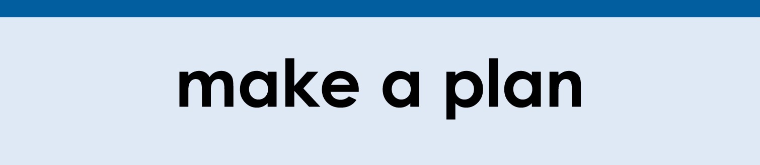


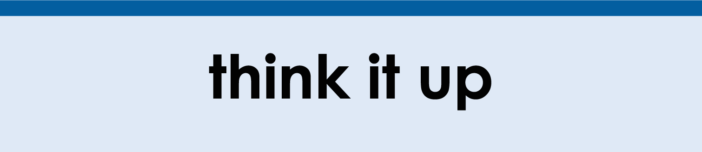
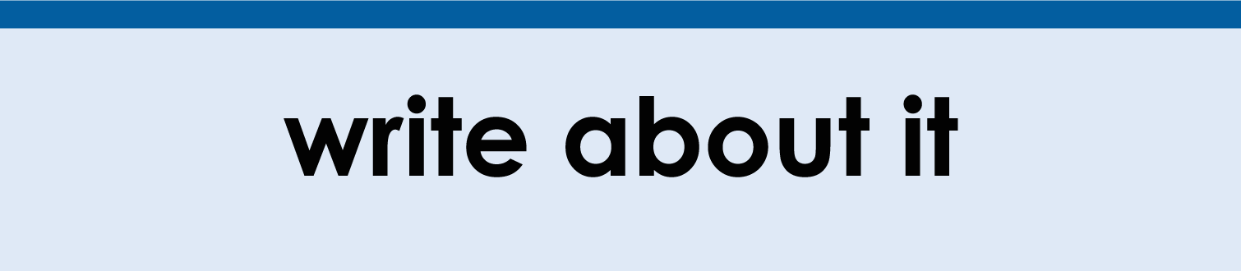
(click on a button to go directly to that step)
Notes:
The thinkalong toolkit includes assessment-style items with answer keys. A digital version (poster) of the thinkalong routine and daily questions for teacher and students’ reference is also included.

Slide 2
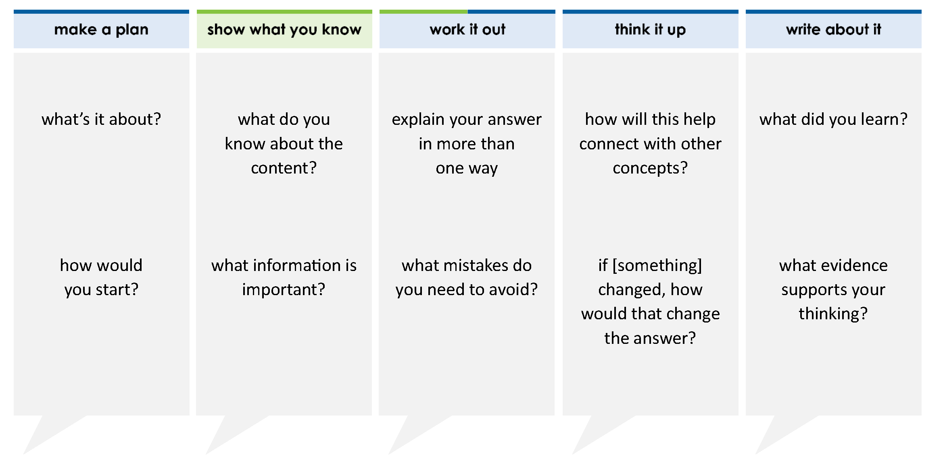
Brenda is sixty-four and twenty-three hundredths inches tall. What is the value of the digit in the tenths place?
A 4
B 0.03
C 6
D 0.2
thinkalong routine
stimulus
Notes:
Throughout the week, use the guiding questions from the thinkalong routine to lead student thinking and discussion around the selected stimulus (problem, text, or visual) aligned to a high-impact standard/concept.

Slide 3
make a plan
Notes:
make a plan
The goal of the first 5-10 minutes of the routine is just for students to explore. We are engaging the “tools to know” process standards and using the selected problem, text, or visual to activate memory around the designated content for the week.
If you’re using a problem as the stimulus, students don’t solve the problem or even see the answer choices yet! In this part of the routine, students practice making a plan, getting started, and thinking about what they will need to answer the question based on the vocabulary and/or visuals included.

Slide 4
what’s it about?
Brenda is sixty-four and twenty-three hundredths inches tall.
how would you start?
Notes:
make a plan: Use the guiding questions on the routine to drive the thinking and discussion with students as you explore the selected stimulus.
This item was selected to address, loopback, or intervene on representing whole numbers and decimals because:
Word form is complex for students.
Students need a strategy to help them transfer between word and standard/expanded form. In this problem, students will go from word form to standard form.

Slide 5
show what you know
Notes:
show what you know
The goal of the second 10 minutes in the routine is for students to talk using the problem, text, or visual to show what they know about this concept! This part of the routine allows students and teacher to talk about, share, and clarify the content (vocabulary, visuals, activities, common mistakes, connections, key ideas, important info/details, etc.).

Slide 6
what do you know about the content?
Brenda is sixty-four and twenty-three hundredths inches tall.
what information is important?
Notes:
show what you know - option 1: Use these questions from the routine, along with the selected stimulus, to activate memory, review content, correct learning mistakes, and clarify misconceptions. Be sure discussion includes important information related to the selected stimulus.
important information about this item:
Clues include and require an understanding of important academic vocabulary: hundredths, tenths.
Students must read and clarify all of the clues:
Sixty four = 64
And = indicates that we are moving from the whole number and decimal number side of the place value chart
Twenty-three hundredths = 0.23
Students would benefit from a place value chart, discussing place value understandings and relationships, and/or representing the number using different forms (standard form, expanded form, expanded notation, etc.).

Slide 7

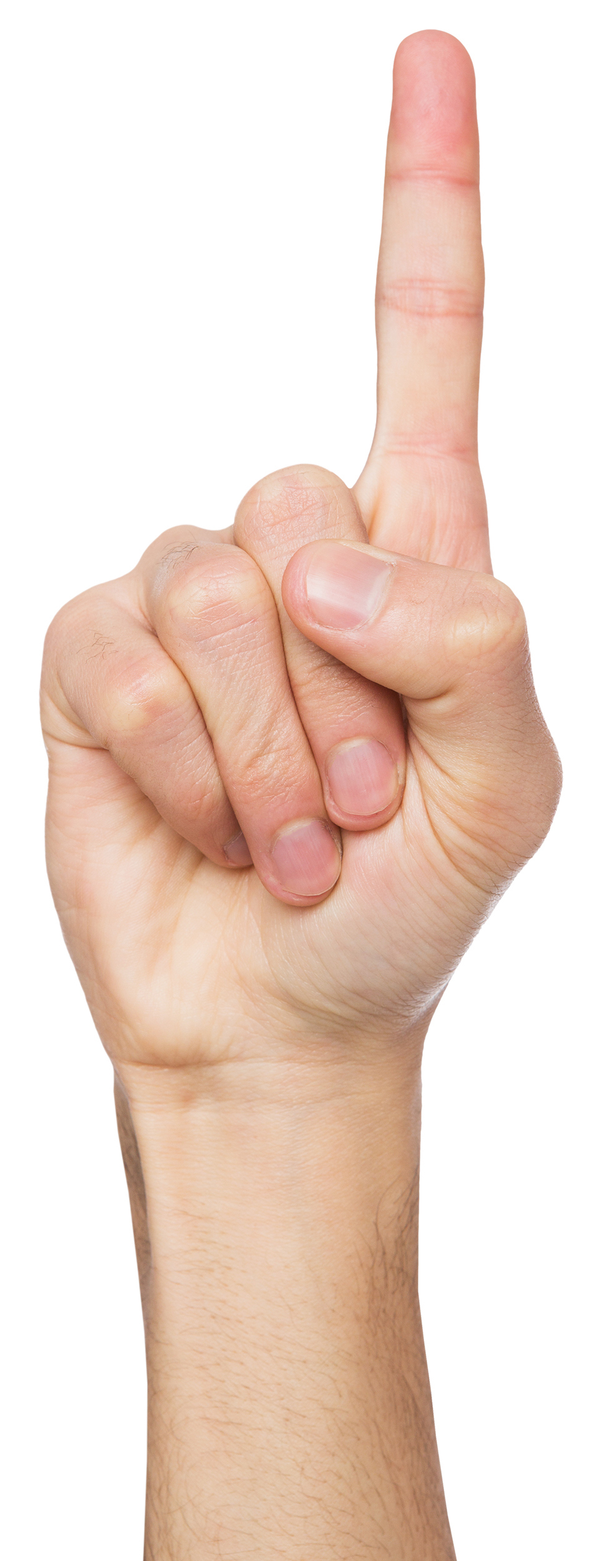

FACT
FIB
Notes:
show what you know - option 2: fact or fib (rehearsal and practice instructional strategy)
purpose
Students review important content and clarify misconceptions by determining which statements are facts and which are fibs in a fact or fib showdown game. Fact or fib is an effective strategy for brain dumping and to activate memory, review content, correct learning mistakes, and clarify misconceptions and that will engage students with the guiding questions from the “show what you know” column and selected weekly stimulus.
instructions
Students create FACT and FIB cards using post it notes, index cards, scratch paper, white boards or use their fingers.
They hold their cards while teacher presents students with a statement (fact or fib) relating to the concept, visual, text, or test item.
Allow students 5-8 seconds to infer if the statement is a fact or a fib.
Students think and prepare to justify their answer until the teacher calls out, “One! Two! Three! Showdown!” at which time all students hold up either the fact or fib card to represent their choice.
Students then take turns explaining and justifying their thinking with a partner or small group.
Observe students’ thinking and clarify/verify as appropriate.
Reveal correct answer and provide rationale.

Slide 8
There is a 4 in the ones place.
FACT!
Brenda is sixty-four and twenty-three hundredths inches tall.
100s | 10s | 1s | . | 0.1 | 0.01
 | 6 | 4 | . | 2 | 3
1-2-3 SHOWDOWN
Notes:
show what you know - option 2, round 1 rationale
This is a FACT because sixty-four is 64, which means a 6 in the tens place and a 4 in the ones place.
Students need to be flexible in moving from word form to standard form.

Slide 9
The value of the digit in the tenths place is 0.03.
100s | 10s | 1s | . | 0.1 | 0.01
 | 6 | 4 | . | 2 | 3
Brenda is sixty-four and twenty-three hundredths inches tall.
(3 x 0.01) is 0.03 or 3 hundredths
FIB!
1-2-3 SHOWDOWN
Notes:
show what you know - option 2, round 2 rationale
This is a FIB because 23 hundredths means 0.23 so 2 is in the tenths and 3 is in the hundredths place.
Students may confuse the tenths and hundredths place values.

Slide 10
The value of the digit 2 in this number is 20.
100s | 10s | 1s | . | 0.1 | 0.01
 | 6 | 4 | . | 2 | 3
Brenda is sixty-four and twenty-three hundredths inches tall.
(2 x 0.1) is 0.2 or 2 tenths
FIB!
1-2-3 SHOWDOWN
Notes:
show what you know - option 2, round 3 rationale
This is a FIB because the 2 in (0.23) is in the tenths place. Students may confuse 0.23 with 23.
Students need to be flexible in moving from word form to standard form.

Slide 11
work it out
Notes:
work it out
The goal of the third 10 minutes of the routine is for students to work out the problem and defend their answer. We want students to prove why their chosen response is right and explain why the incorrect answers are wrong.

Slide 12
explain your answer in more than one way
Brenda is sixty-four and twenty-three hundredths inches tall. What is the value of the digit in the tenths place?
A 4
B 0.03
C 6
D 0.2
what mistakes do you need to avoid?
Notes:
work it out - option 1: Correct learning mistakes and clarify misconceptions by answering the question but be sure students not only solve but also prove why their chosen response is right and explain why the incorrect answers are wrong.
Be sure discussion includes:
A is incorrect - the 4 is in the ones place
B is incorrect - the student most likely confused the hundredths place with the tenths place
C is incorrect - the student most likely confused ”tenths” with “tens”
D is correct

Slide 13
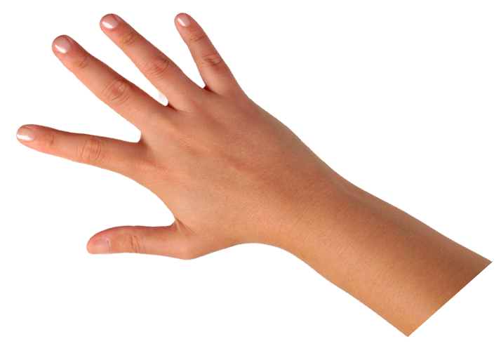
IQ slap down
A
B
C
D
Round 1 - Worst Answer
Round 2 - Best Distractor
Round 3 - Correct Answer
Notes:
work it out - option 2: IQ slap down (learning from mistakes instructional strategy)
purpose
Students analyze or practice assessment questions by determining the worst answer, the distractor, and the correct answer through a slap-down game.
instructions
Students create a set of A-B-C-D cards using sticky notes, index cards, or scratch paper.
Organize students into thinking partners or small groups.
Facilitate 3 rounds of IQ Slap Down with the selected weekly assessment item:
Round 1: At teacher’s signal, students slap down the WORST answer, justify with their partner, and pick up their cards. Teacher clarifies.
Round 2: At teacher’s signal, students slap down the DISTRACTOR answer, justify with their partner, and pick up their cards. Teacher clarifies.
Round 3: At teacher’s signal, students slap down the CORRECT answer, justify with their partner, and pick up their cards. Teacher clarifies.
Observe students’ thinking and clarify/verify as appropriate.
Answer “work it out questions” from think along routine.

Slide 14
Brenda is sixty-four and twenty-three hundredths inches tall. What is the value of the digit in the tenths place?
A 4
B 0.03
C 6
D 0.2
64.23
4 ones
Round 1 Worst Answer
1-2-3 Slap Down
Notes:
work it out - option 2: round 1 rationale
A is incorrect - the 4 is in the ones place.
A is the worst answer because it follows the least likely pattern for student error.

Slide 15
100s | 10s | 1s | . | 0.1 | 0.01
 | 6 | 4 | . | 2 | 3
Brenda is sixty-four and twenty-three hundredths inches tall. What is the value of the digit in the tenths place?
A 4
B 0.03
C 6
D 0.2
a common error is mixing up the tenths and hundredths place
a common error is mixing up tens and tenths
Round 2 Best Distractor
1-2-3 Slap Down
Notes:
work it out - option 2: round 2 rationale
B is incorrect - the student most likely confused the hundredths place with the tenths place.
C is incorrect - the student most likely confused ”tenths” with “tens.”
Either of these is a best distractor because it is common for students to confuse the tenths place with the hundredths place. Students likely assume that the digits to the right of the decimal point follow a symmetrical pattern to those to the left of the decimal point (ones, tens, hundreds), OR they lack understanding of why the hundredths place value would be less than the tenths place value.

Slide 16
Brenda is sixty-four and twenty-three hundredths inches tall. What is the value of the digit in the tenths place?
A 4
B 0.03
C 6
D 0.2
Round 3 Correct Answer
1-2-3 Slap Down
Notes:
work it out - option 2: round 3 rationale
D is correct - in 64.23 the two is in the tenths place so the value is 0.2 or 2 tenths.
After IQ slap down, answer the “work it out” questions from the thinkalong routine:
explain your answer in more than one way
what mistakes do you need to avoid?

Slide 17
think it up
Notes:
think it up
The goal of the fourth 10 minutes of the routine is for us to change things up so students can practice with novelty and transfer.

Slide 18
how will this help connect with other concepts?
Brenda is sixty-four and twenty-three hundredths inches tall. What is the value of the digit in the tenths place?
A 4
B 0.03
C 6
D 0.2
how does writing this number in expanded notation help?
if the question asked about the digit (not the "value of the digit"), how would that change the answer?
Notes:
think it up - option 1: Use the guiding questions on the routine to drive the thinking and discussion with students as they reflect on the work of the routine so far -- the thinking around the content and the problem, text or visual. Then, have students analyze how all of that can help them as they work on or think through other content or solving future problems.
If the question asks about the digit (rather than the 'value of the digit’) ... then the answer would just be 2 (rather than 0.2).

Slide 19
compare/contrast model
Celina wrote a number.
the digit in the millions place is a 7
the digit in the thousands place is a 4
the digit in the hundredths place is a 6
Which number could be the number Celina wrote?
A 75,364,000.16
B 37,054,000.61
C 57,364,000.16
D 97,475,600.61
Brenda is sixty-four and twenty-three hundredths inches tall. What is the value of the digit in the tenths place?
A 4
B 0.03
C 6
D 0.2
Notes:
think it up - option 2 compare/contrast model (extending thinking instructional strategy)
purpose
This is an effective strategy to facilitate a structured, supported, and engaging way for kids to answer the “think it up” questions and analyze 2 similar yet different items or visuals aligned to the same standard.
instructions
Divide students into groups of 3.
In each group, students CONTRAST the items by discussing/writing 2-3 attributes of each item.
In each group, students COMPARE the items by discussing/writing 2-3 attributes both items share.
Groups share out 1 of their differences and 1 of their similarities.
Observe and listen to students’ thinking and clarify/verify as appropriate.

Slide 20
write about it
Notes:
write about it
The goal of the last 10 minutes of the routine is for students to reflect on the routine and write about how it affected their understanding and confidence around the content and problem-solving process.

Slide 21
what did you learn?
Brenda is sixty-four and twenty-three hundredths inches tall. What is the value of the digit in the tenths place?
A 4
B 0.03
C 6
D 0.2
explain why answer A is wrong
what evidence supports your thinking?
create and write about a model that would help
Notes:
write about it: The goal of the last 10 minutes of the routine is to solidify learning and have students practice communicating what they know in writing.
Ask students to:
think about the activities, questions, discussions, and the selected problem, text or visual for this week’s thinkalong routine
talk with a partner or in a small group about what they learned and the evidence that supports their thinking
write their answers on a piece of paper or in their notebooks
Review areas in which students may need more support.

