Slide 1





(click on a button to go directly to that step)
Notes:
The thinkalong toolkit includes assessment-style items with answer keys. A digital version (poster) of the thinkalong routine and daily questions for teacher and students’ reference is also included.

Slide 2
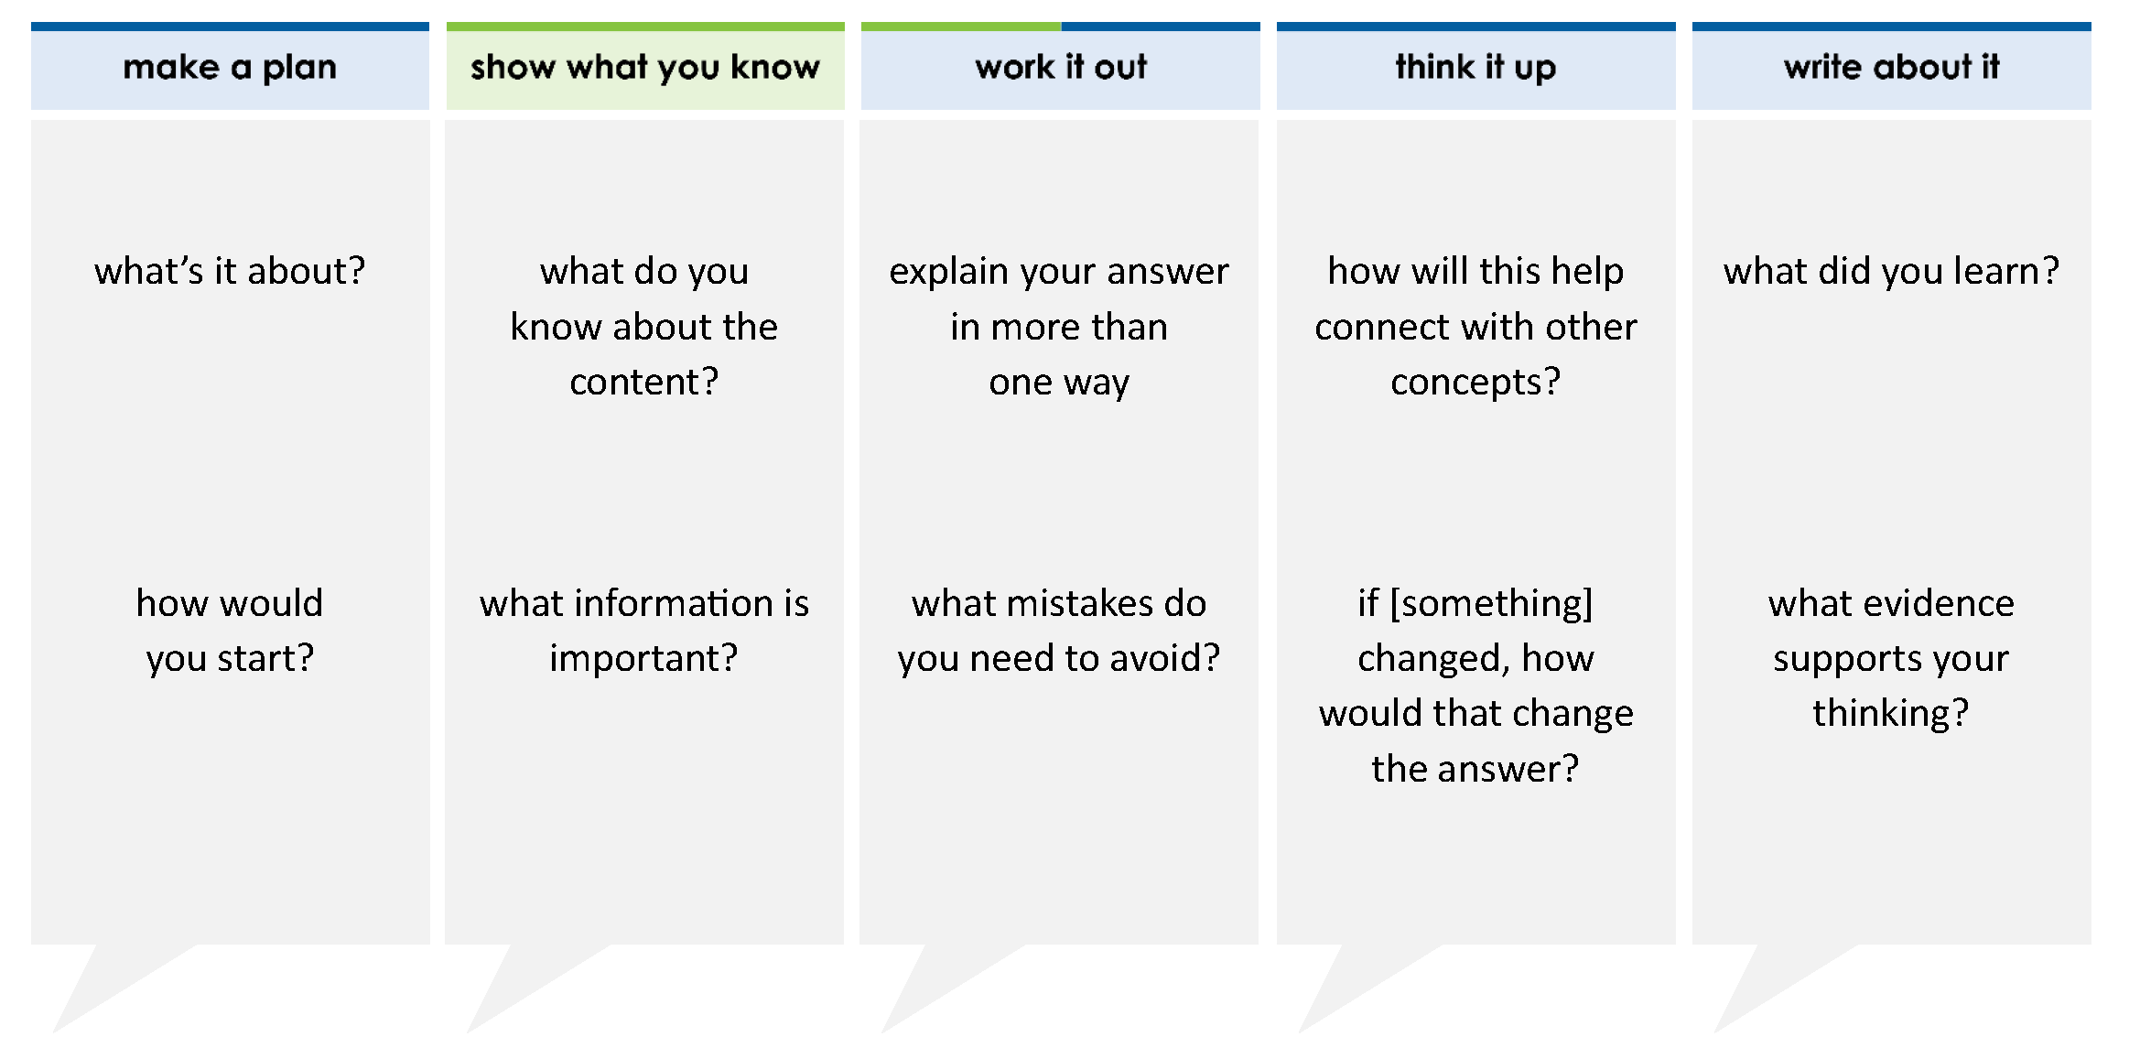
Create a mixed number equivalent to the decimal.
79.04 =
thinkalong routine
stimulus
Notes:
Throughout the week, use the guiding questions from the thinkalong routine to lead student thinking and discussion around the selected stimulus (problem, text, or visual) aligned to a high-impact standard/concept.

Slide 3
make a plan
Notes:
make a plan
The goal of the first 5-10 minutes of the routine is just for students to explore. We are engaging the “tools to know” process standards and using the selected problem, text, or visual to activate memory around the designated content for the week.
If you’re using a problem as the stimulus, students don’t solve the problem or even see the answer choices yet! In this part of the routine, students practice making a plan, getting started, and thinking about what they will need to answer the question based on the vocabulary and/or visuals included.

Slide 4
what’s it about?
79.04 =
how would you start?
Notes:
make a plan: Use the guiding questions on the routine to drive the thinking and discussion with students as you explore the selected stimulus.
This item was selected to address, loopback, or intervene on equivalent fractions because:
Students need to understand place value of decimals deeply enough to be fluid between decimal and fraction form.
It involves students starting with a decimal and turning it into a mixed number.

Slide 5
show what you know
Notes:
show what you know
The goal of the second 10 minutes in the routine is for students to talk using the problem, text, or visual to show what they know about this concept! This part of the routine allows students and teacher to talk about, share, and clarify the content (vocabulary, visuals, activities, common mistakes, connections, key ideas, important info/details, etc.).

Slide 6
what do you know about the content?
79.04 =
what information is important?
Notes:
show what you know - option 1: Use these questions from the routine, along with the selected stimulus, to activate memory, review content, correct learning mistakes, and clarify misconceptions. Be sure discussion includes important information related to the selected stimulus.
important information about this item:
Clues include and require an understanding of important academic vocabulary: decimal, fraction, equivalent, tenths, hundredths
Students must read and clarify all of the clues:
79 is a whole number so it sits alone
4 is in the hundredths place
Since 4 is in the hundredths, as a fraction it’s written 4 over 100
Students would benefit from:
Saying this number out loud (seventy-nine and four hundredths)
Writing it in word form
Creating a place value chart and identifying each digit’s place value
Identifying what a numerator is (not just that it is the “top number” of a fraction but its actual meaning and importance)
Identifying what a denominator is (not just that it is the “bottom number” of a fraction but its actual meaning and importance)

Slide 7



FACT
FIB
Notes:
show what you know - option 2: fact or fib (rehearsal and practice instructional strategy)
purpose
Students review important content and clarify misconceptions by determining which statements are facts and which are fibs in a fact or fib showdown game. Fact or fib is an effective strategy for brain dumping and to activate memory, review content, correct learning mistakes, and clarify misconceptions and that will engage students with the guiding questions from the “show what you know” column and selected weekly stimulus.
instructions
Students create FACT and FIB cards using post it notes, index cards, scratch paper, white boards or use their fingers.
They hold their cards while teacher presents students with a statement (fact or fib) relating to the concept, visual, text, or test item.
Allow students 5-8 seconds to infer if the statement is a fact or a fib.
Students think and prepare to justify their answer until the teacher calls out, “One! Two! Three! Showdown!” at which time all students hold up either the fact or fib card to represent their choice.
Students then take turns explaining and justifying their thinking with a partner or small group.
Observe students’ thinking and clarify/verify as appropriate.
Reveal correct answer and provide rationale.

Slide 8
the 7 is in the tenths place
10s | 1s | . | 0.1 tenths | 0.01 hundredths
7 | 9 | . | 0 | 4
79.04 =
the tens place is a different and higher value than the tenths place
FIB!
1-2-3 SHOWDOWN
Notes:
show what you know - option 2, round 1 rationale
This is a FIB because the 7 is in the tens place.
Students struggle with identifying the different place values and how they equate to a fraction.
Students also often mistake the tens and tenths place.

Slide 9
0.04 =
4
100
FACT!
79.04 =
10s | 1s | . | 0.1 tenths | 0.01 hundredths
7 | 9 | . | 0 | 4
1-2-3 SHOWDOWN
Notes:
show what you know - option 2, round 2 rationale
This is a FACT because the 4 is in the hundredths place so it should be represented as 4 over 100.
Students often struggle to turn the decimal values into a fraction.

Slide 10
79.04 is equivalent to seventy-nine and four hundredths
79.04 is equivalent to seventy-nine and four hundredths
FACT!
79.04 =
10s | 1s | . | 0.1 tenths | 0.01 hundredths
7 | 9 | . | 0 | 4
1-2-3 SHOWDOWN
Notes:
show what you know - option 2, round 3 rationale
This is a FACT because the way the number is read is seventy-nine and four hundredths.
Students often struggle with turning the fraction into a decimal and vice versa. By putting it in word form, it may help students identify its equivalent mixed number form.

Slide 11
work it out
Notes:
work it out
The goal of the third 10 minutes of the routine is for students to work out the problem and defend their answer. We want students to prove why their chosen response is right and explain why the incorrect answers are wrong.

Slide 12
explain your answer in more than one way
Create a mixed number equivalent to the decimal.
79.04 =
what mistakes do you need to avoid?
Notes:
work it out - option 1: Correct learning mistakes and clarify misconceptions by answering the question but be sure students not only solve but also prove why their chosen response is right and explain why the incorrect answers are wrong.
Be sure discussion includes:
How to read a decimal number aloud (write in word form)
The value of the 4

Slide 13
9
  make the case
7
4
defend why your answer might be correct/incorrect
what 1-2 pieces of evidence do you have?
Create a mixed number equivalent to the decimal.
79.04 =
4
79
10
4
79
100
94
70
100
Notes:
work it out - option 2: make the case (learning from mistakes instructional strategy)
free virtual dice available in the lead4ward app and at: www.lead4ward.com/dice
purpose
Students correct learning mistakes and clarify misconceptions by justifying/proving why their assigned response is right OR explain why their assigned response is an incorrect answer.
instructions
Organize students into groups (no larger than 4).
Assign each team a potential answer (choice).
Groups huddle to determine if their answer choice is “correct/innocent” by explaining why and providing (at most) 2 pieces of evidence…or “incorrect/guilty” by explaining why and providing (at most) 2 pieces of evidence.
Students prosecute and defend arguments.
Observe students’ thinking/responses and clarify/verify as appropriate.
be sure discussion includes:
Visuals or models students might use to prove their justification.
Discourse around strategies, clues and/or vocabulary that support their justification.
The chosen incorrect answer(s) suggests a common misconception, guessing pattern, clue picking, stopping too soon, and relying on tricks.
Student-driven discourse.

Slide 14
think it up
Notes:
think it up
The goal of the fourth 10 minutes of the routine is for us to change things up so students can practice with novelty and transfer.

Slide 15
how will this help connect with money?
Create a mixed number equivalent to the decimal.
79.04 =
if the 4 moved to the tenths place, how would that change the answer?
Notes:
think it up - option 1: Use the guiding questions on the routine to drive the thinking and discussion with students as they reflect on the work of the routine so far -- the thinking around the content and the problem, text or visual. Then, have students analyze how all of that can help them as they work on or think through other content or solving future problems.

Slide 16
  odd one out
Create a mixed number equivalent to the decimal.
79.04 =
Which equality statement is true?
A 2.50 =
B 2.05 =
C 2.05 =
D 2.50 =
250
10
205
100
25
10
25
100
Create a mixed number that represents 76.9. Move the correct answer to each box. Not all answers will be used.
76.9=
Which decimal is equivalent to ?
A 0.087
B 0.87
C 8.7
D 7.100
87
100
76
760
769
9
90
900
1
10
100
Notes:
think it up - option 2 odd one out (extending thinking instructional strategy)
purpose
Students compare/contrast four visuals, assessment questions, words, characters, historical figures, etc. and justify their thinking by defending which they think is the odd one out.
instructions
Divide students into groups of 4.
In each group, students divide the images/problems amongst their group and take turns describing their image/problem.
Students compare and contrast the images/problems.
Students determine which one is the odd one out and why.
Groups share out their selected odd one out and justification.
Observe and listen to students’ thinking and clarify/verify as appropriate.

Slide 17
write about it
Notes:
write about it
The goal of the last 10 minutes of the routine is for students to reflect on the routine and write about how it affected their understanding and confidence around the content and problem-solving process.

Slide 18
what did you learn?
Create a mixed number equivalent to the decimal.
79.04 =
what would a model of this fraction look like?
4
79
what evidence supports your thinking?
100
explain why 4 tenths would be the incorrect fraction
Notes:
write about it: The goal of the last 10 minutes of the routine is to solidify learning and have students practice communicating what they know in writing.
Ask students to:
think about the activities, questions, discussions, and the selected problem, text or visual for this week’s thinkalong routine
talk with a partner or in a small group about what they learned and the evidence that supports their thinking
write their answers on a piece of paper or in their notebooks
Review areas in which students may need more support.

